Slide 1
Is future transport here?
Comparing EV efficiency to ICE vehicles
Group 6: Julian Pecino, Jeremy Del Moral, Elijah Montgomery, Joshna Rence

Slide 2
Questions to be Answered:
Budget
Is an EV appropriate for a median income family earning $51,000?
EV as Commercial Vehicle
Is an EV appropriate for commercial applications including cross country transport?
Affordability
Affordability considerations over a 10-year span for Tesla Model 3 and Toyota Camry

Slide 3
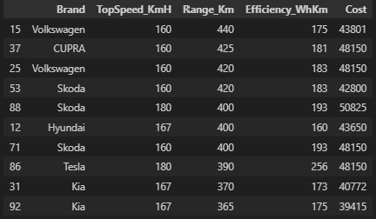
Dataset Used:

Slide 4
Budget Considerations:
Average median income is $51,000

Slide 5
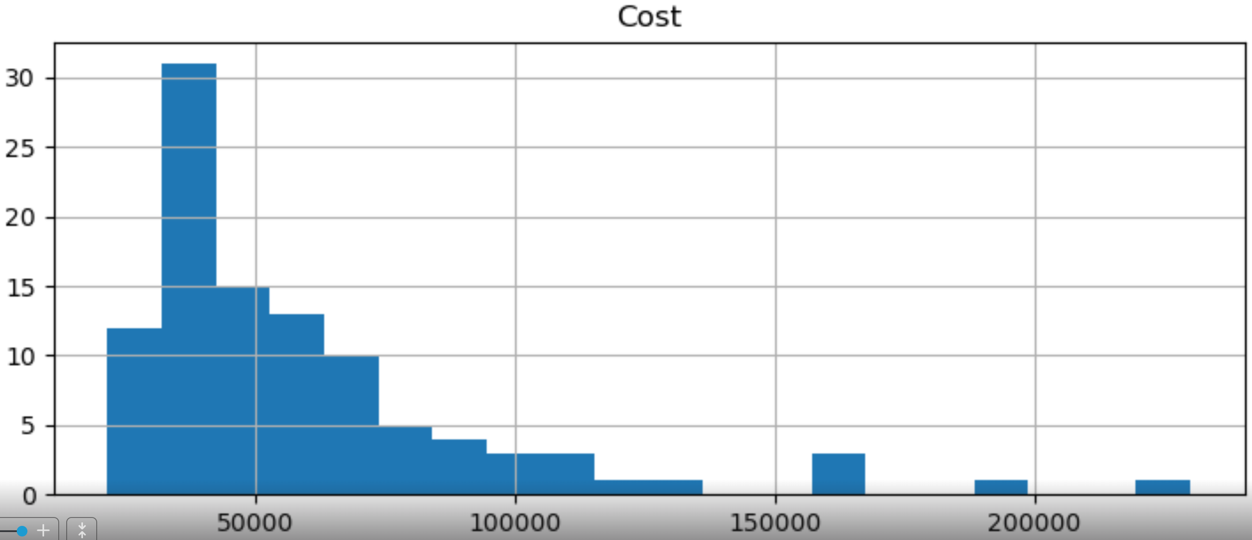
Budget Considerations:
Average median income is $51,000

Slide 6

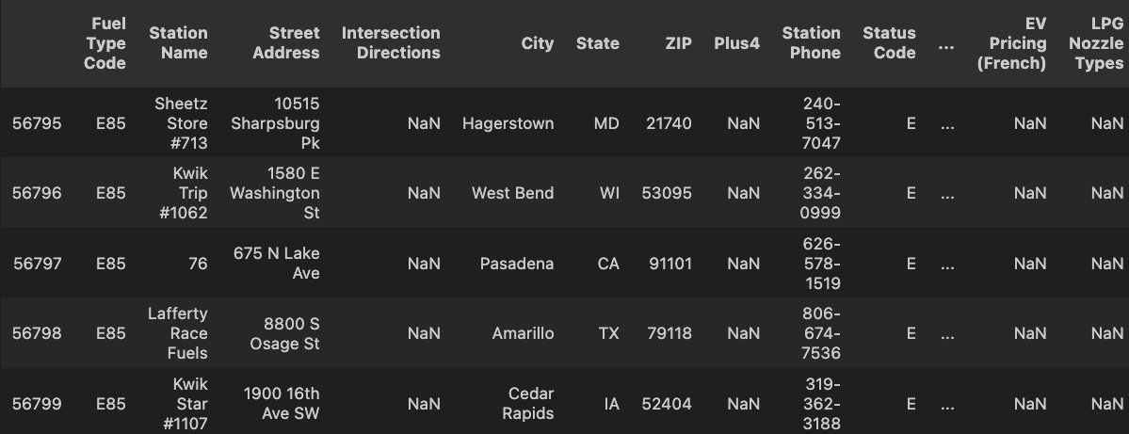

Dataset Used:

Slide 7
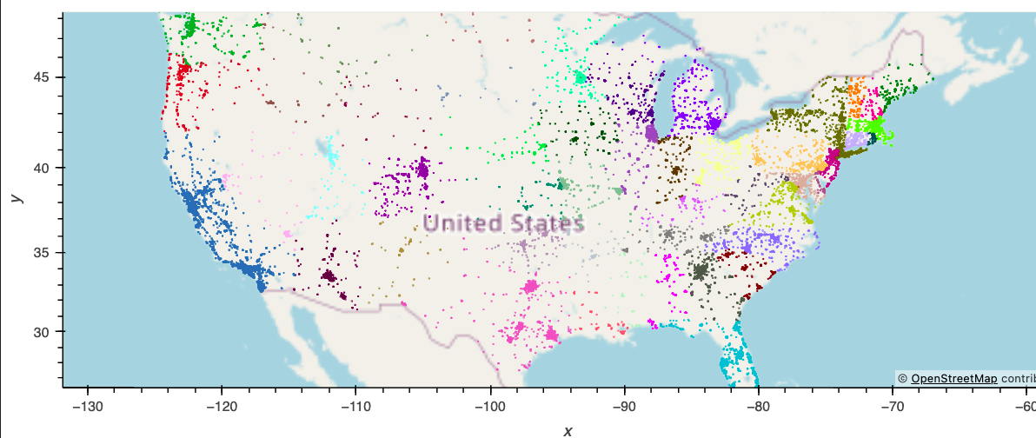
Commercial Applications:
Charging stations well established in major cities and coastal cities
Charging limited in the Midwest and Southern States

Slide 8
Commercial Applications:

Slide 9
Dataset Used:

Slide 10
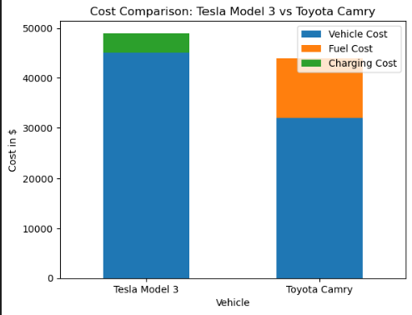
Affordability:
T

Slide 11
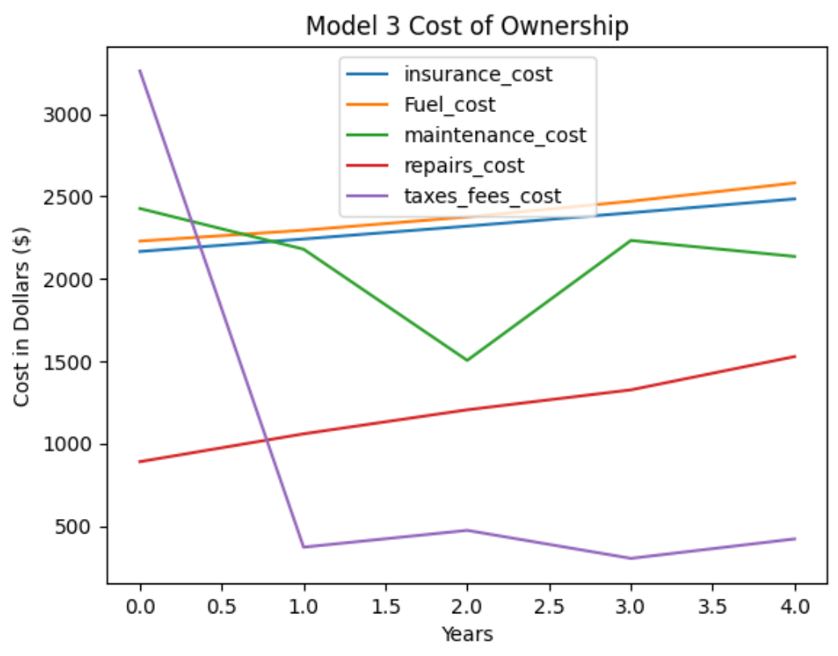
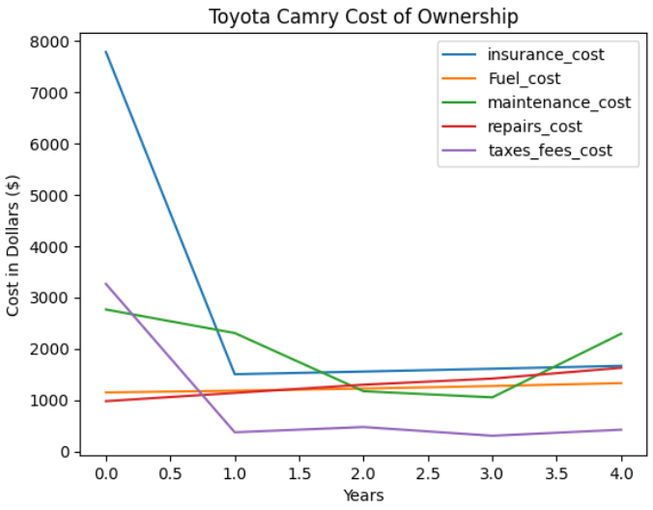
Affordability:
M

Slide 12
Questions:

